Slide 1
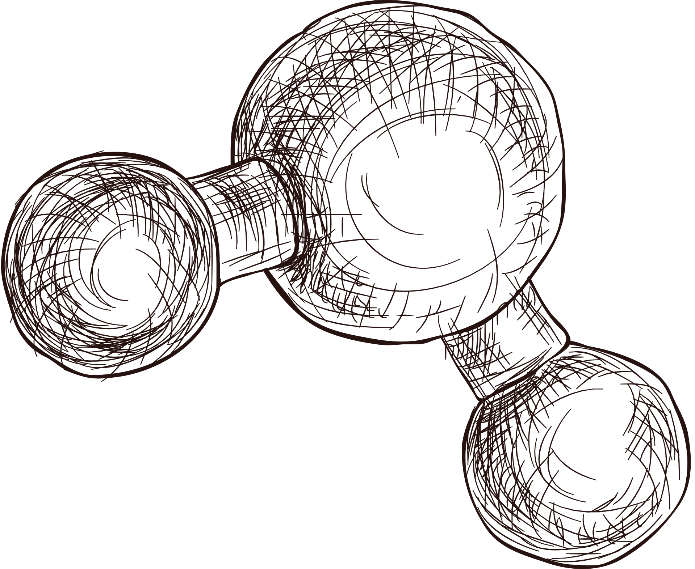

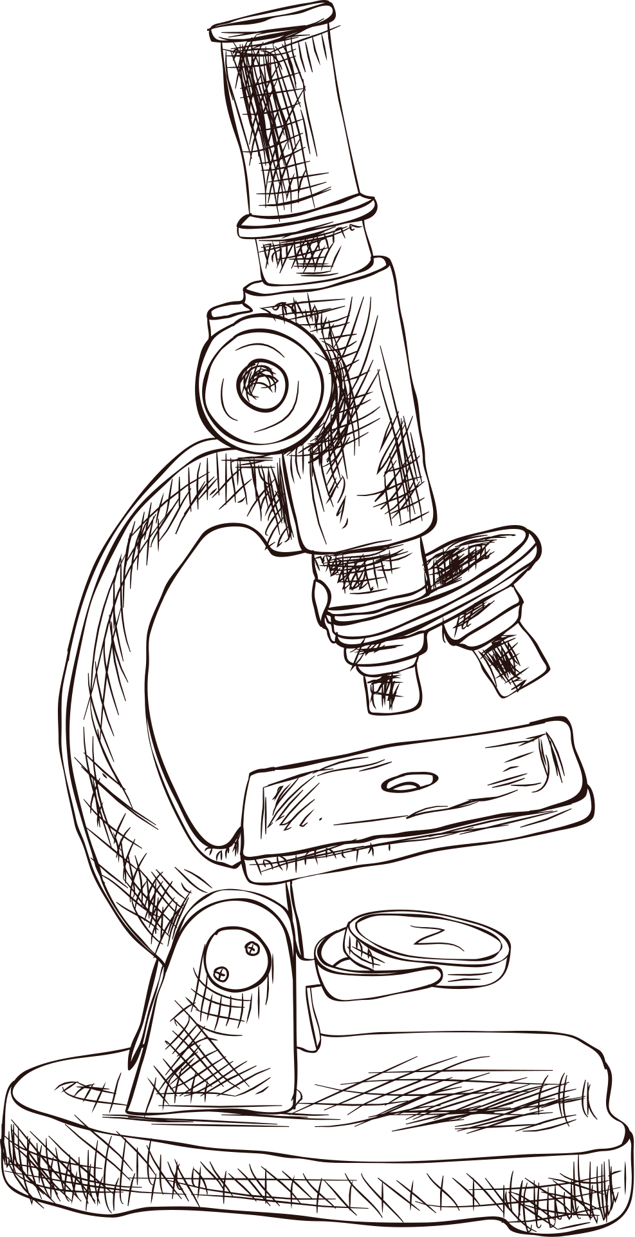
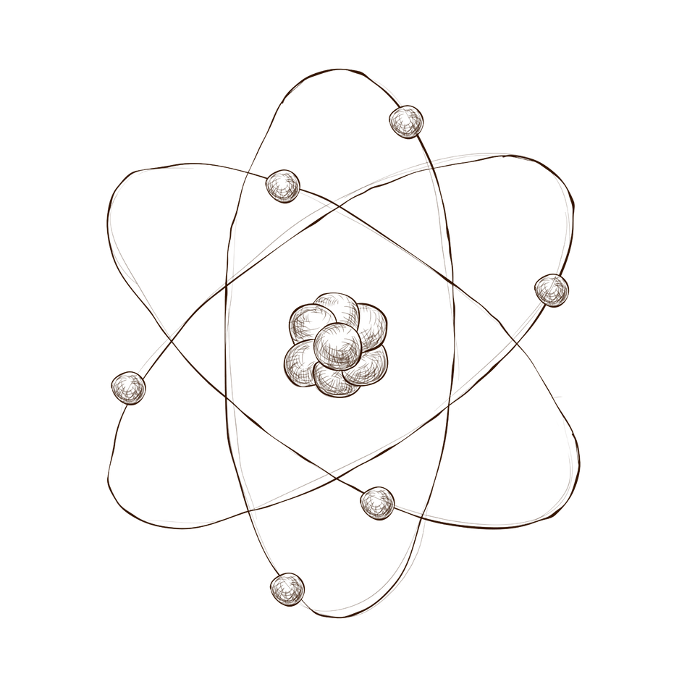

A GSA-BASED IMPROVED MPPT SYSTEM FOR PV
Generation
Presented by
Nguyễn Khắc Hoàng -18230
Phùng Quang Nhật - 10221071
Nguyễn Đình Bảo Khang - 10221062

Slide 2

The
research
01
Maximum Power Point Tracking
02
PSO and GSA
03
Test run

Slide 3
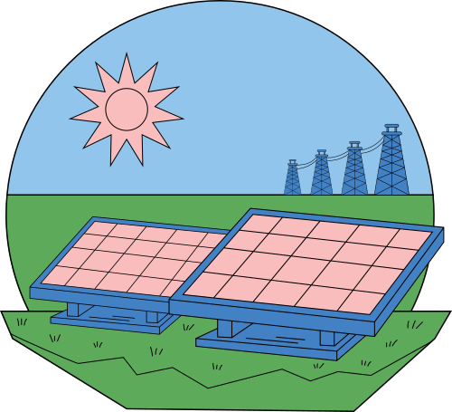
Maximum Power Point Tracking
(MPPT)

Slide 4
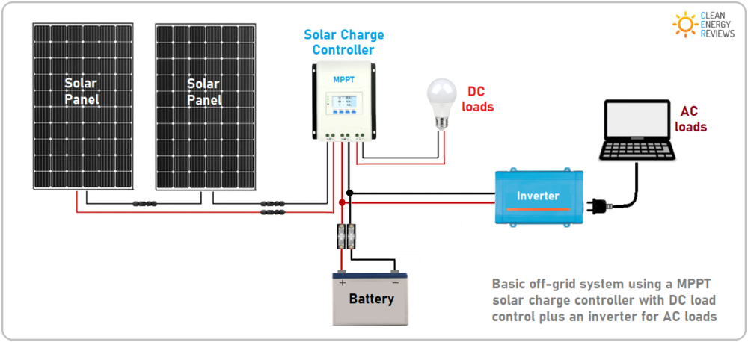

What is MPPT?
Definition:
MPPT boosts solar panel performance.
How it Works:
Smart technology adjusts panel settings for maximum power output.
Key Benefit:
Significantly improves solar system efficiency.
Applications:
Used in solar charge controllers, grid-tied inverters, and various solar power setups.

Slide 5
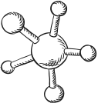
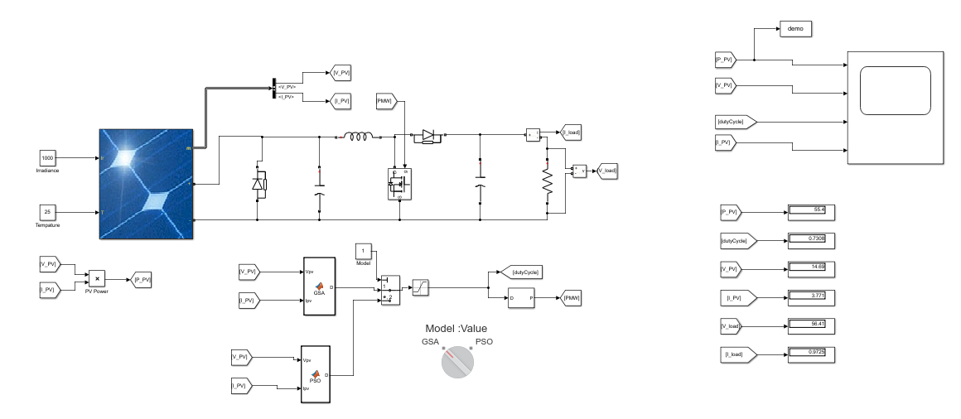

A Photovoltaic System

Slide 6
Algorithm for MPPT

Slide 7
Particle Swarm Optimization (PSO)
and
Gravitational Search Algorithm (GSA)

Slide 8
What is PSO?
In computer science, particle swarm optimization (PSO) is a smart way of solving problems. It uses a bunch of candidates called particles and helps them move around smartly to find the best solution. Each particle knows its best position and learns from others to explore and find the overall best solutions over time. It's like a team effort to figure out the best answer.

Slide 9

Particle Swarm Optimization (PSO) is a nature-inspired optimization algorithm based on the behavior of flocks of birds. Particles, representing potential solutions, move through a solution space, adjusting their positions based on their own experiences and the experiences of the entire group. PSO is a heuristic method that, although not guaranteed to find the global optimal solution, is effective in searching for good solutions in complex spaces. for good solutions in complex spaces.

Slide 10
What is GSA?
Gravitational Search Algorithm (GSA) is a computer-based method that mimics how objects attract each other due to gravity in nature. It's like particles interacting based on their masses. GSA is used to find the best solution to problems by adjusting the positions of these virtual particles, guided by simulated gravitational forces. It's a way computers learn from nature to solve complex problems effectively.

Slide 11
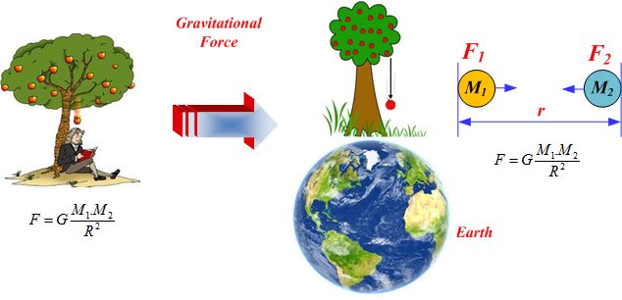
Gravitational search algorithm (GSA) is an optimization algorithm based on the law of gravity and mass interactions. This algorithm is based on Newtonian gravity: "Every particle in the universe attracts every other particle with a force that is directly proportional to the product of their masses and inversely proportional to the square of the distance between them".

Slide 12
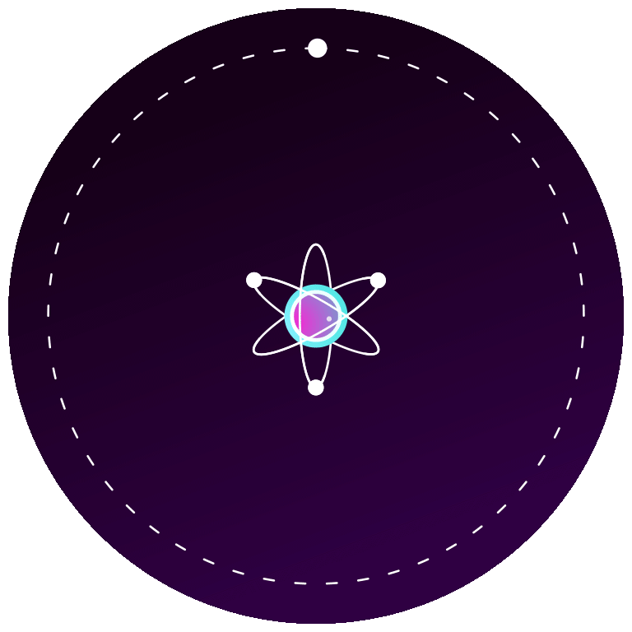

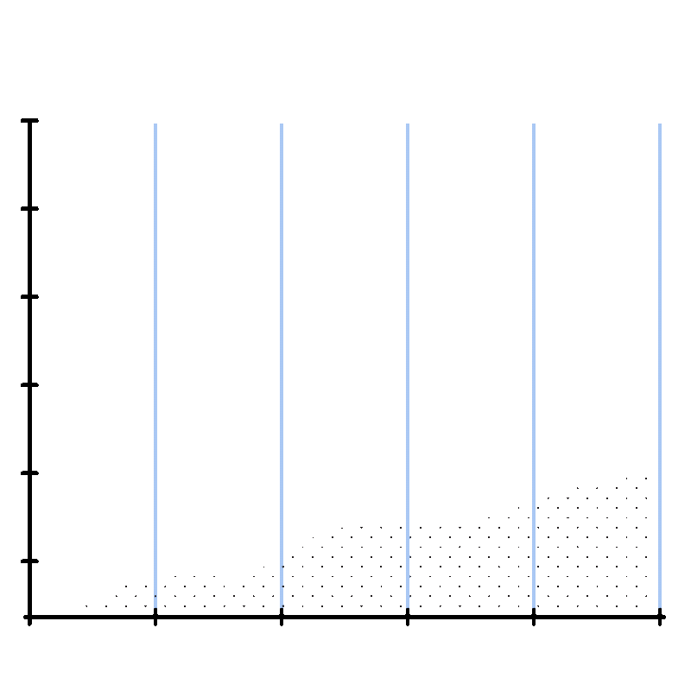
PSO Implementation
Particles
Velocity and Position
Each particle represents a potential MPPT solution (duty cycle).
Each particle adjusts its position (duty cycle) based on its own experience.
Keep track of solution
The algorithm keeps track of the best solution found by any particle.

Slide 13
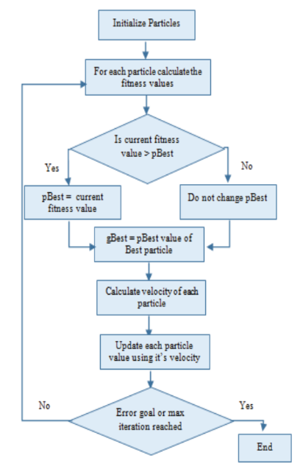
PSO
algorithms

Slide 14


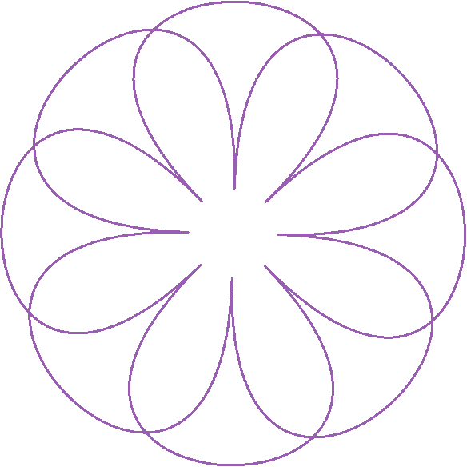

GSA Implementation
Particles
Mass
Each particle represents a potential MPPT solution (duty cycle).
The performance of each particle (how close it is to the maximum power point) determines its mass. Better solutions have more mass.
Attraction
Movement
Particles attract each other based on their mass (performance). Particles with higher performance (mass) attract others more strongly.
Each particle moves towards others based on the gravitational force, adjusting its duty cycle in hopes of finding the optimal point for maximum power output.

Slide 15
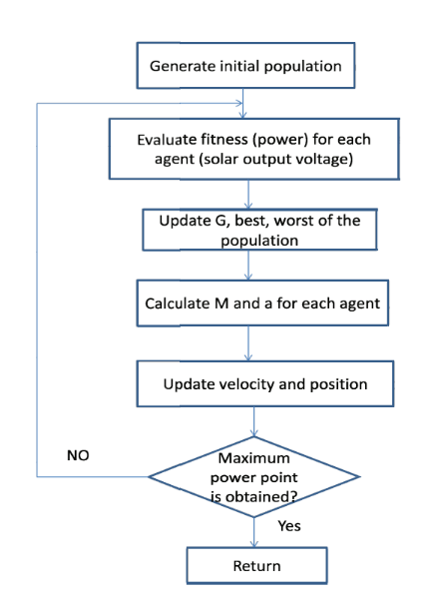
GSA
algorithms

Slide 16
Particle Swarm Optimization
Advantage
Disadvantage
Simplicity: PSO is relatively simple to understand and implement.
Flexibility: PSO can adapt to different characteristics of the solar panel and environmental conditions.
Robustness: It's effective in tracking the global maximum power point under varying conditions.
Risk of Local Minima: Sometimes, PSO may get trapped in a local optimum.
Parameter Sensitivity: The performance of PSO is highly dependent on the choice of parameters like particle velocity and inertia weight.
Overhead: PSO requires a fair amount of computational resources for particle management and velocity calculations.

Slide 17
Gravitational Search Algorithm
Advantage
Disadvantage
Global Search Capability: GSA is effective in exploring the search space and finding the global optimum.
Adaptive: It can adjust to changing solar irradiance and temperature conditions.
No Need for Derivative Information: It can be used for different kinds of problems, showing flexibility.
Slow Convergence: Might take more time to find optimal solutions.
Parameter Sensitivity: Performance depends on choosing the right parameter values.
Limited Application: Not as widely applied or validated in various real-world scenarios.
Constraints Handling: May face challenges when dealing with optimization problems involving constraints.

Slide 18
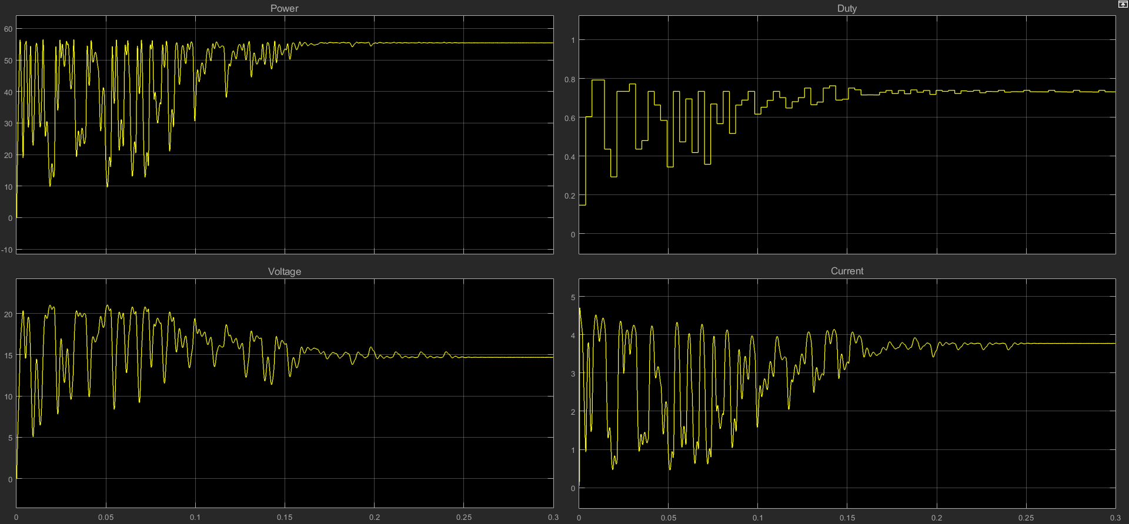
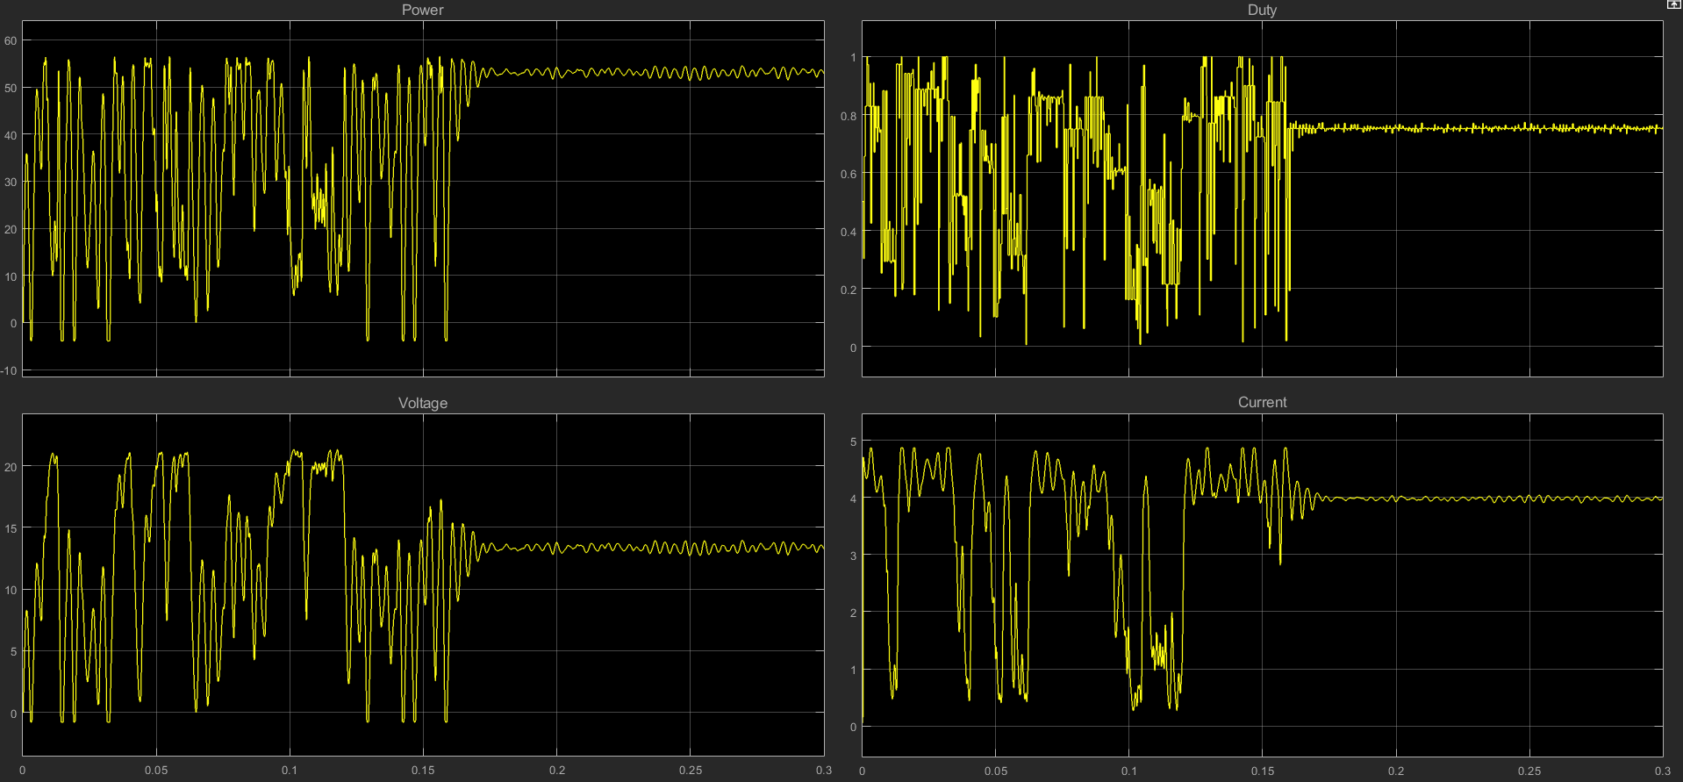
PSO Performance

Slide 19
GSA Performance

Slide 20
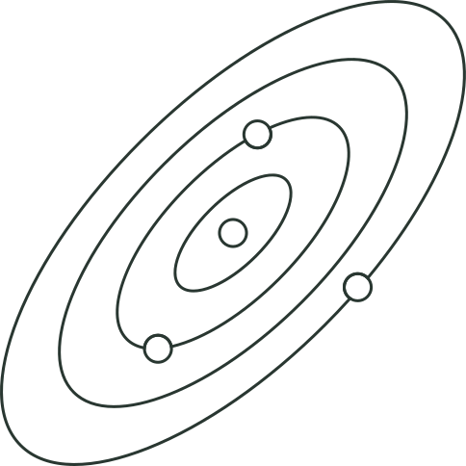
TEST RUN

Slide 21
Thank
you!
Do you have any questions?

